Slide 1
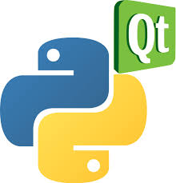
pyQt6

Slide 2


PyQt is a Python binding of the cross-platform GUI toolkit Qt, implemented as a Python plug-in. PyQt is free software developed by the British firm Riverbank Computing.
The PyQt6 library is actually a wrapper around the C++ Qt library, which makes it possible to use it in Python.

Slide 3


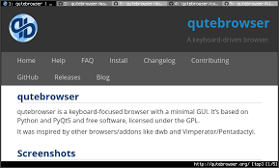
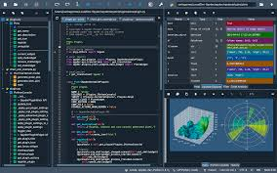
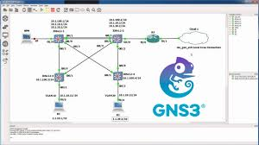
Applications that use PyQt
Dropbox, a file hosting service
OpenShot, a video editing program
qutebrowser, a web browser
with Vim-style key bindings and a minimal GUI.
Spyder, a Python data science IDE
GNS3, a network software emulator

Slide 4
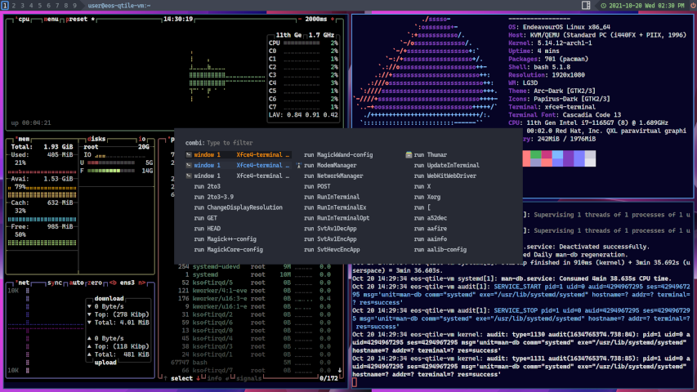

Slide 5
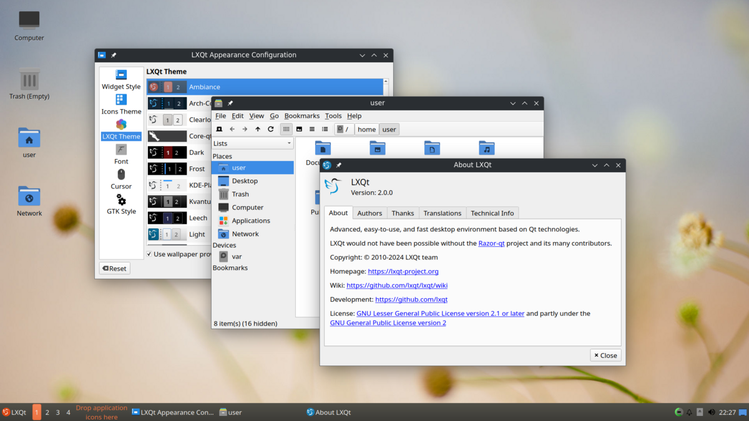

Slide 6
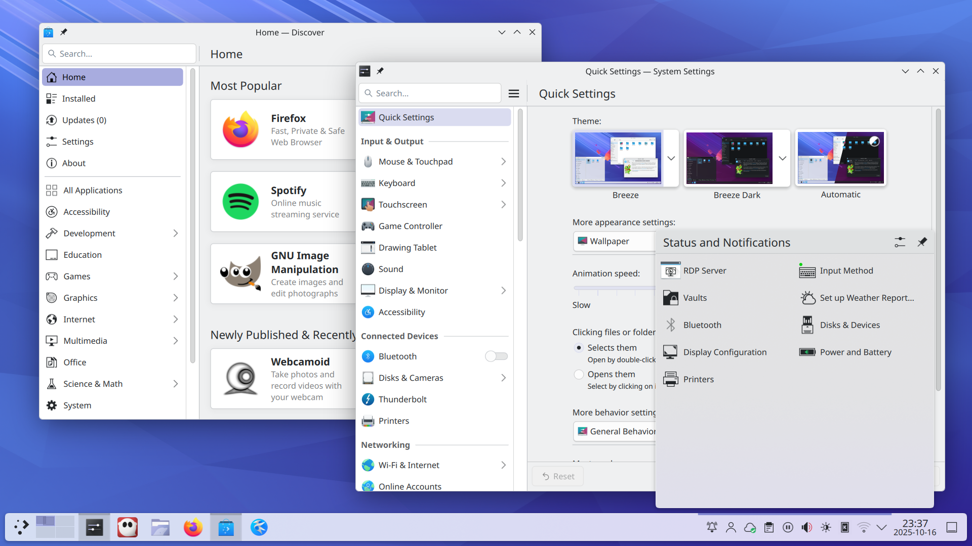

Slide 7



Start
https://www.pythonguis.com/installation/install-pyqt6-linux
$ sudo apt update
$ sudo apt install python3-venv python3-pip
$ mkdir project/ && cd project/
$ python3 -m venv ./venv
$ source venv/bin/activate
(venv) $
(venv) $ pip3 install pyqt6
https://www.pythonguis.com/installation/install-pyqt6-windows
https://www.pythonguis.com/installation/install-pyqt6-mac

Slide 8
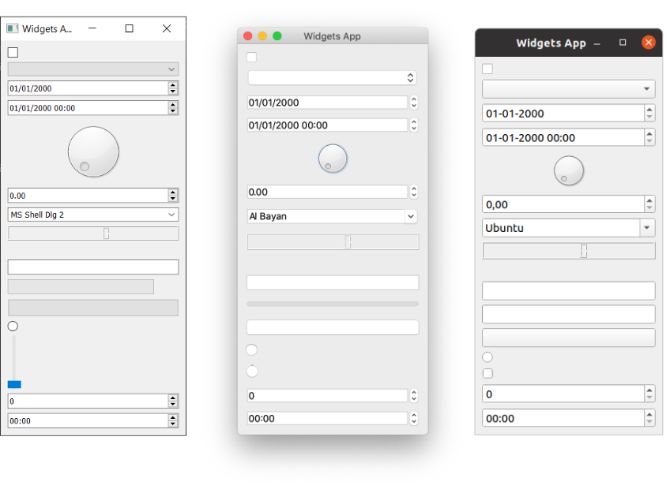

Slide 9

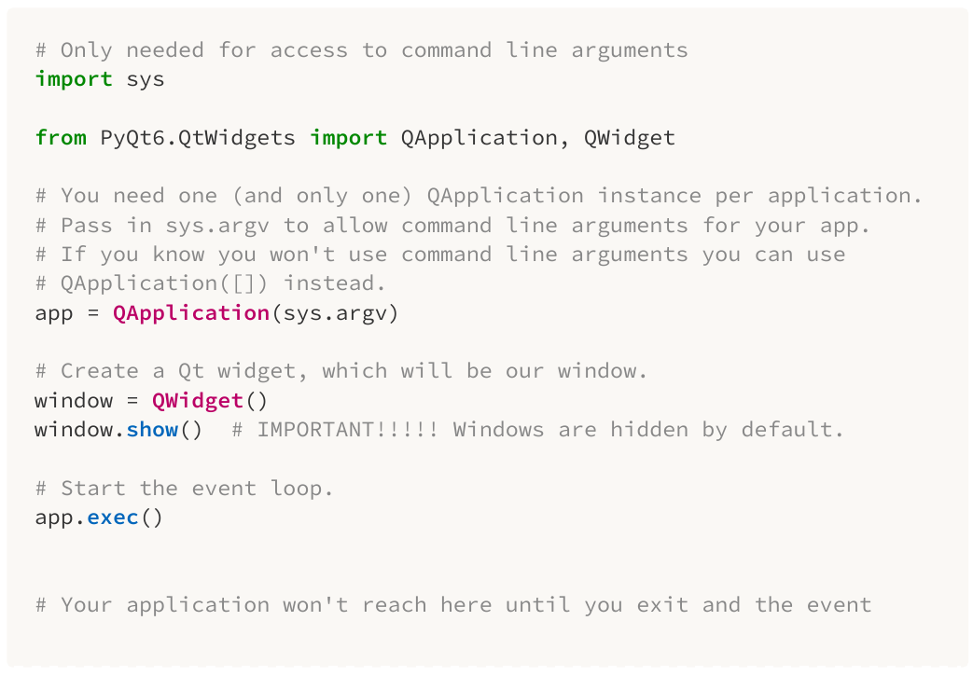
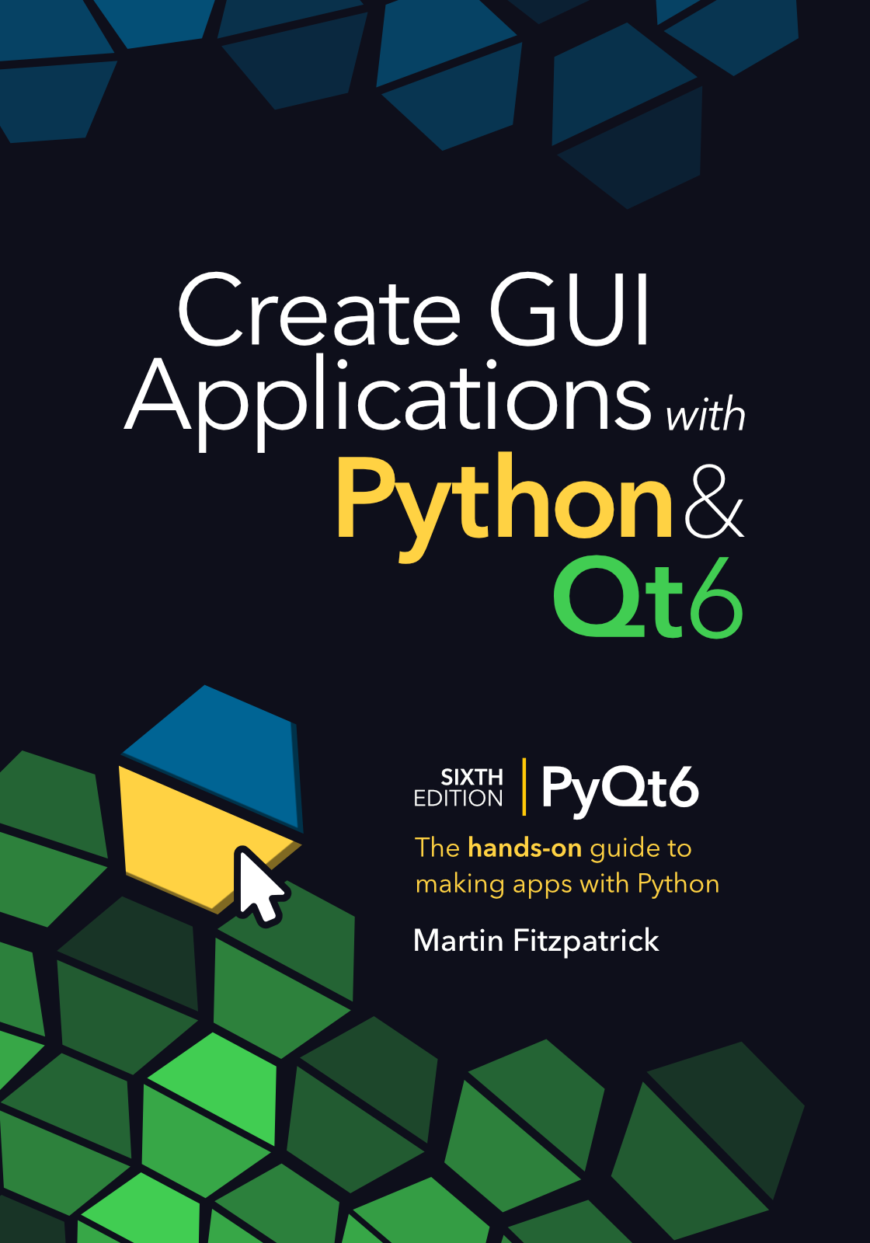
Because this is a Python interface to a C++ library, the naming conventions used within PyQt6 do not adhere to PEP8 standards.
For example, functions and variables are named using mixedCase rather than snake_case.

Slide 10
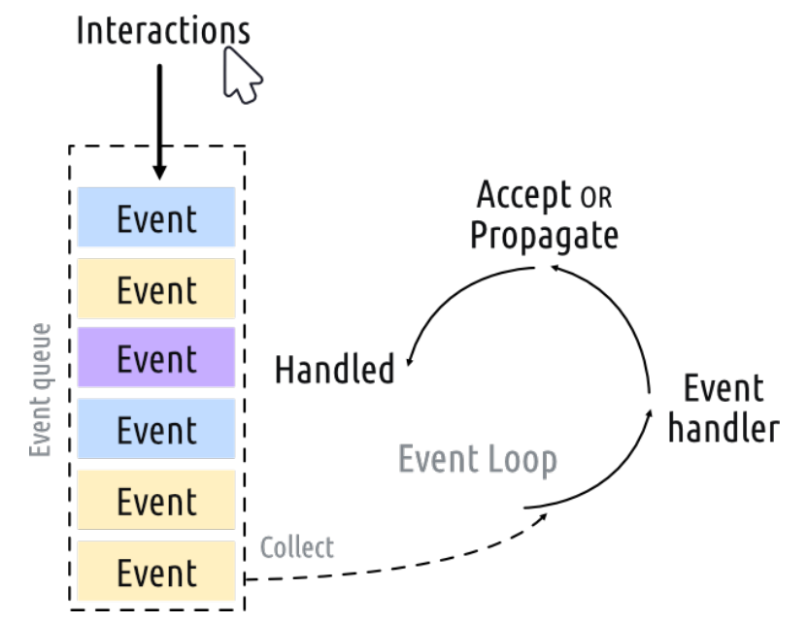

Slide 11
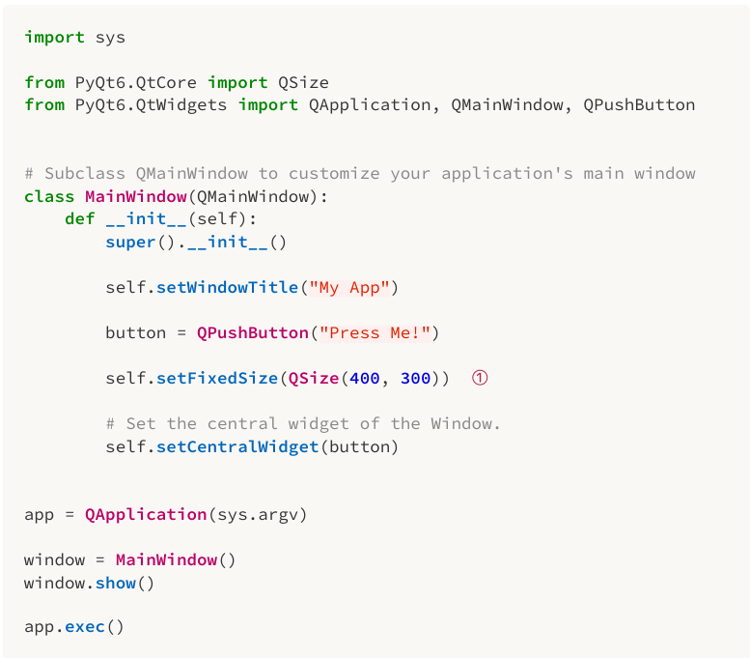
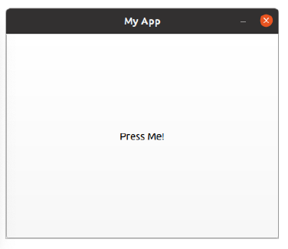
Basic structure:

